Slide 2
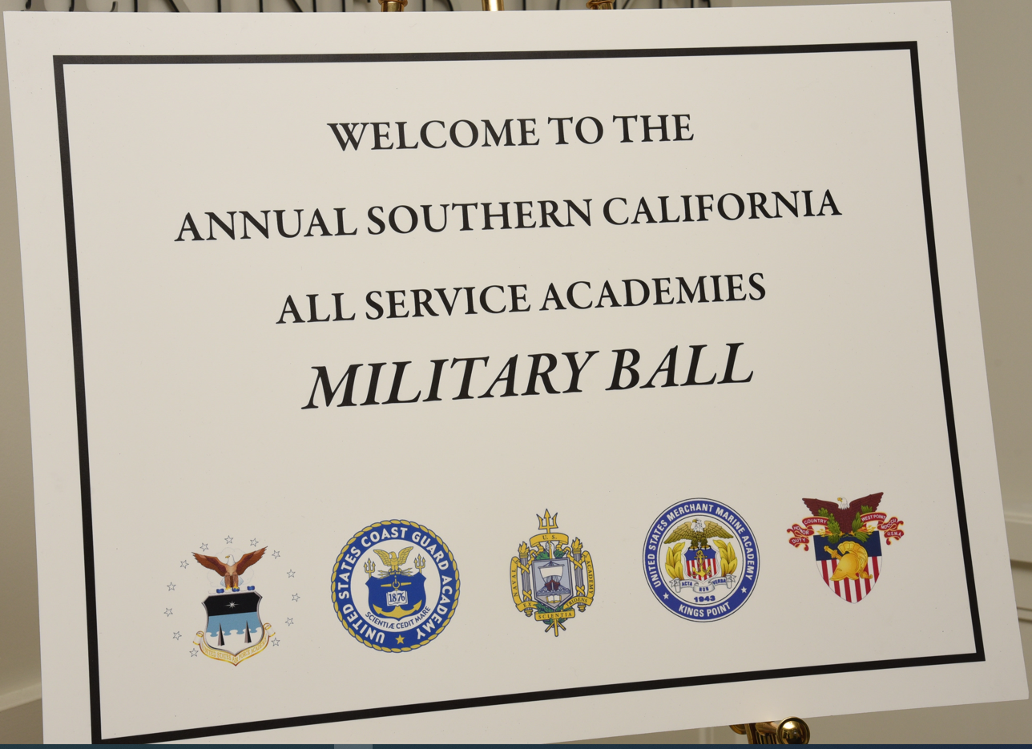

Slide 3
All Academies Military Ball Planning Committee
Kriste Mayes, Denise Sappington, Leilani and Rico Emnace, Kalani Mark, Rob and Thema Beltran, Bertha Romero, Linda Burrows, Maro Magallon, Lluvia Duran, Adeline Sin, Darcy Lewis

Slide 4
Family

Slide 5
EMCEE
Rich Herrera is a national sports talk show host on CBS Sports Radio

Slide 6
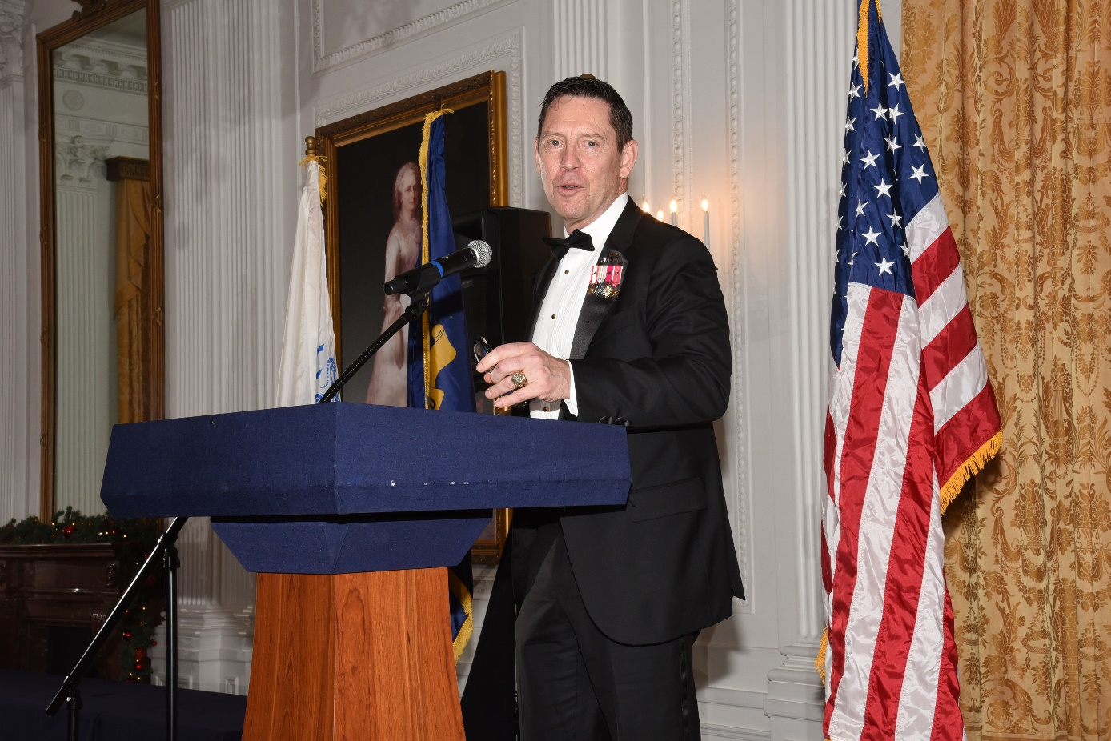
Guest Speaker
LTG Eric J. Wesley

Slide 7
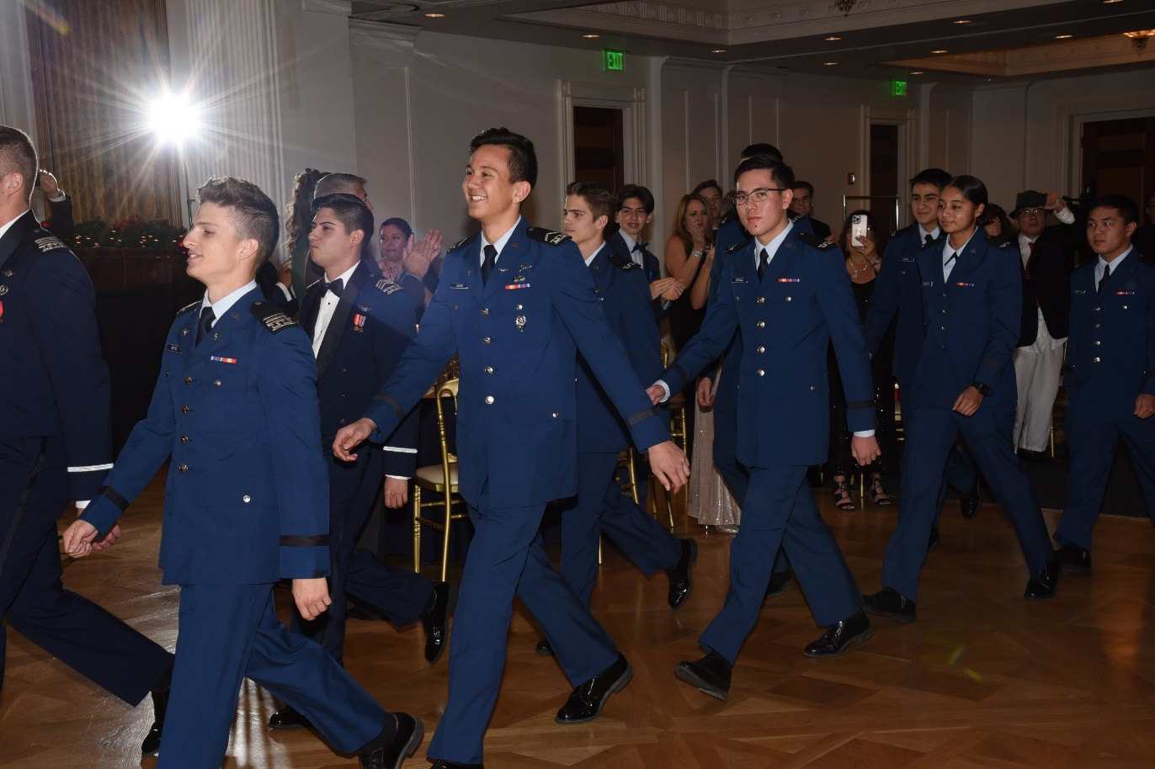
Grand March of cadets and midshipmen by Academy/Class

Slide 8
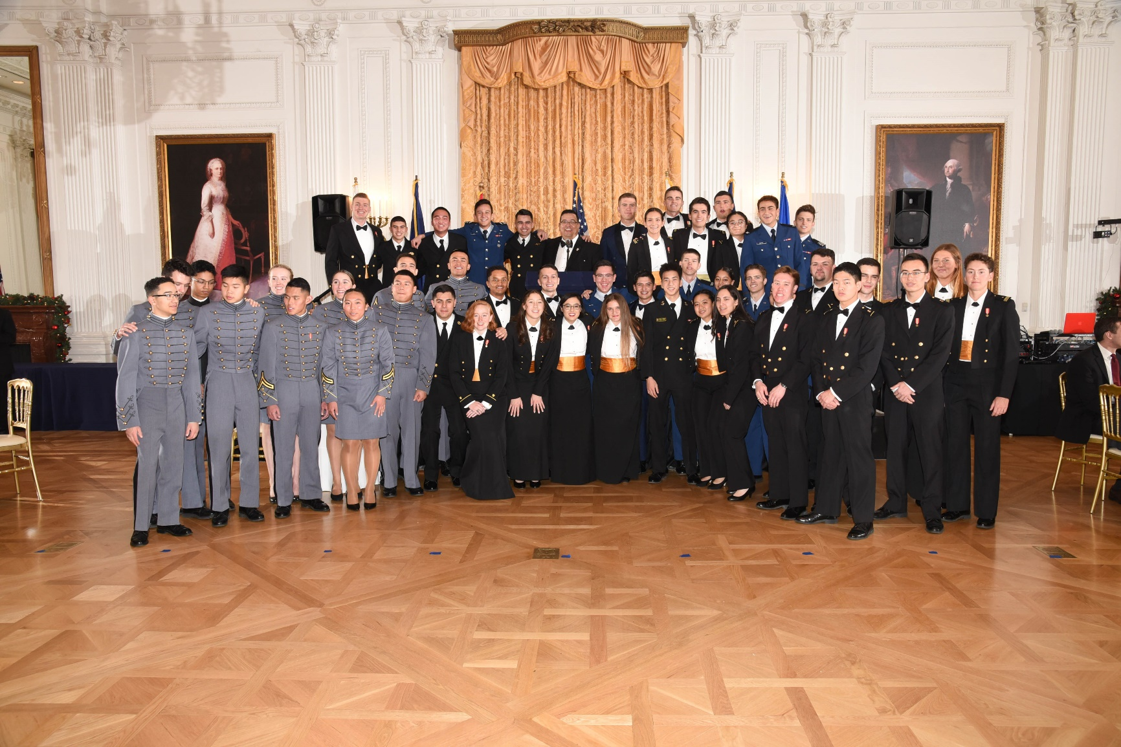

Slide 9
TOASTS
Toastmasters

Slide 10
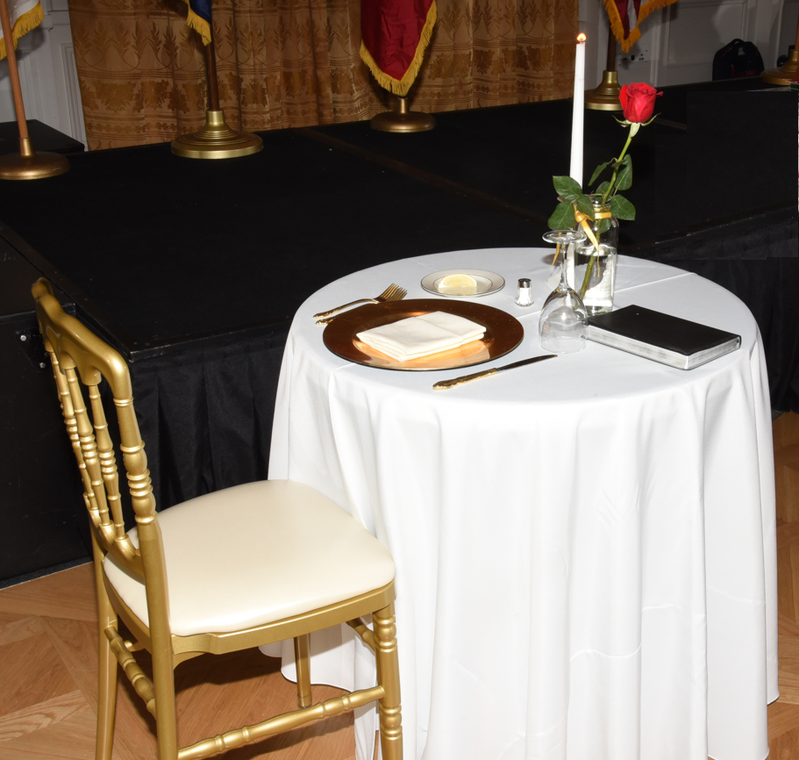
FALLEN COMRADE CEREMONY

Slide 11
PRAYER OF INVOCATION

Slide 12
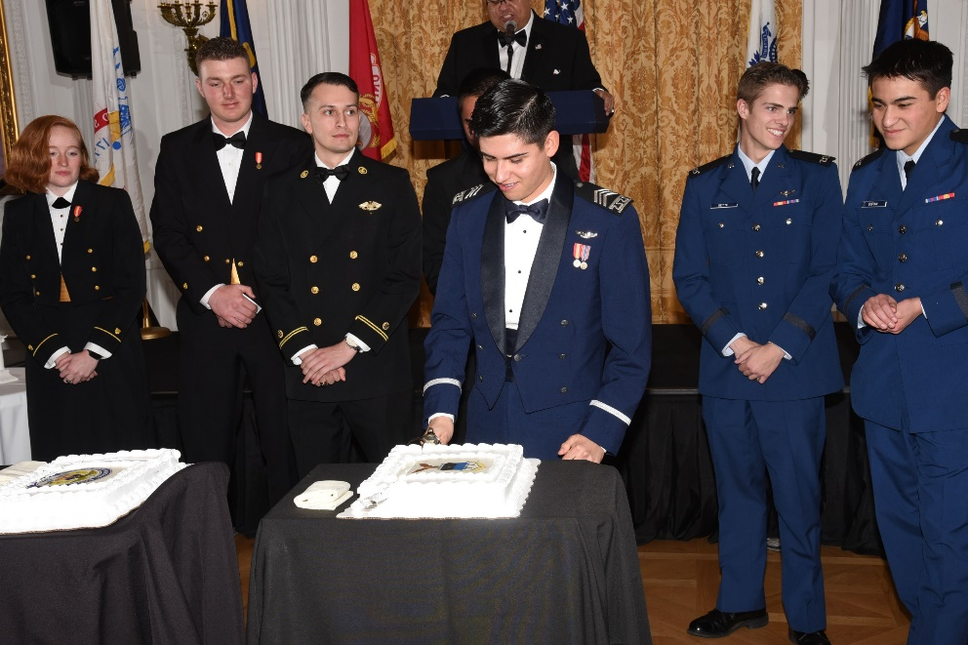
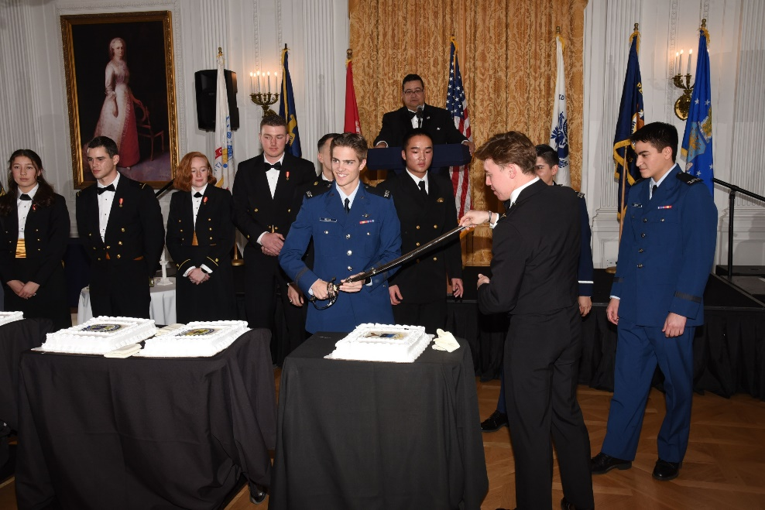
Cake cutting Ceremony

Slide 13
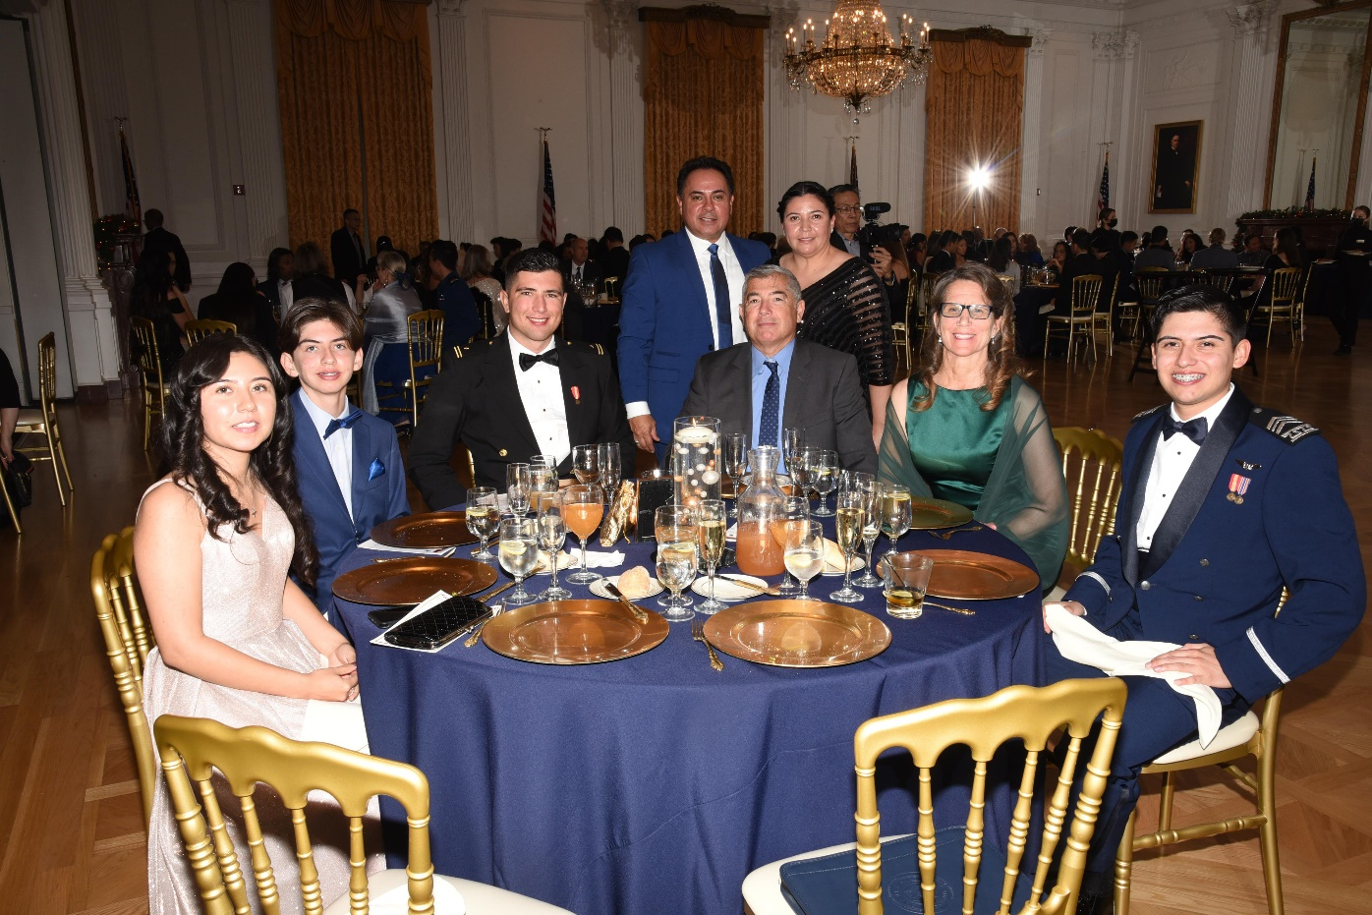
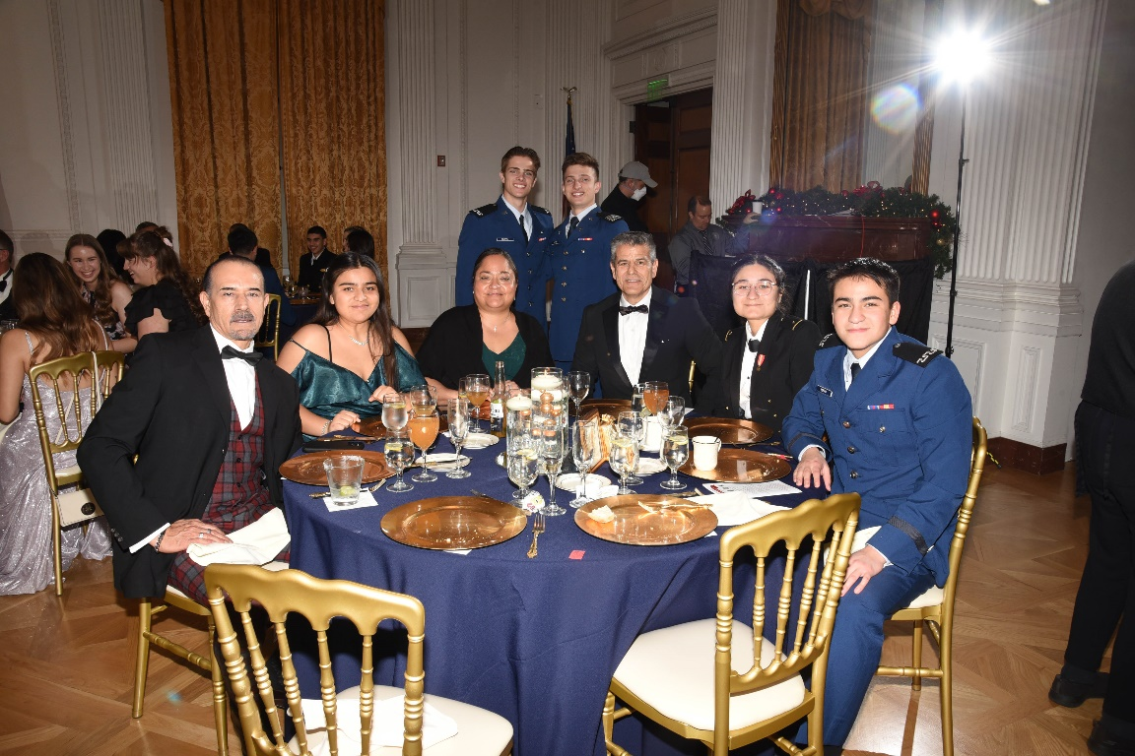

Slide 14
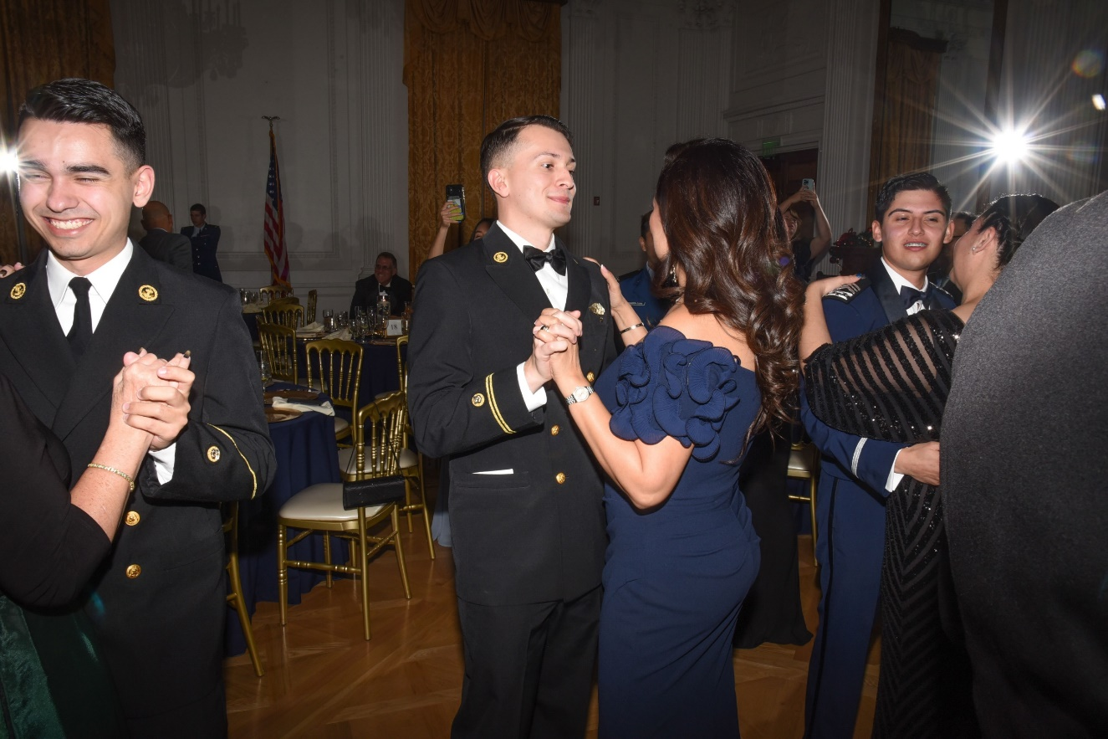
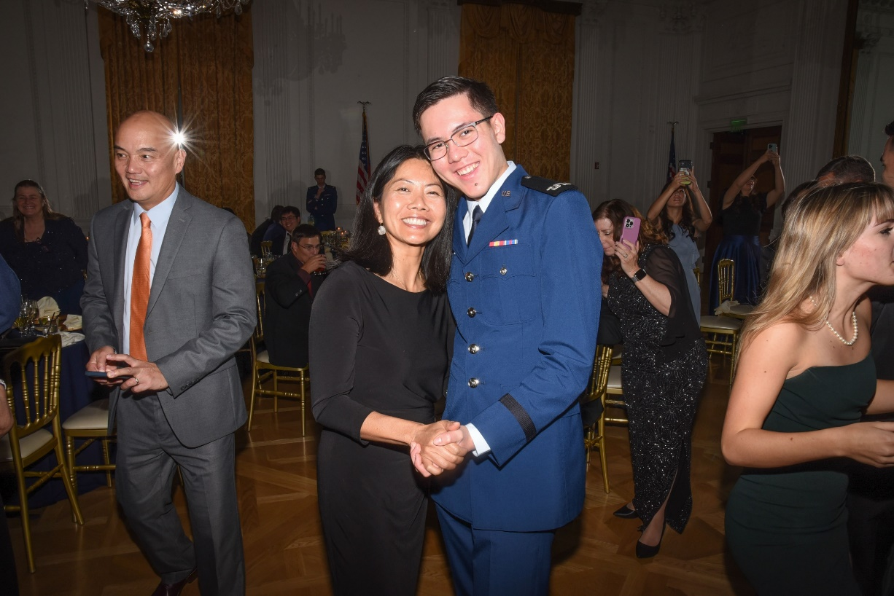

Slide 15
